Slide 1
PCAP file processing
Mustafa Amir Faisal
CS 6350.002 - Big Data Management and Analytics - Project

Slide 2
Outline
Problem Definition
Motivation
Explored tools and techniques
Outcomes (Hadoop Pcap)
Contributions
On Going and Future Work
Conclusion

Slide 3
Problem Definition
PCAP (Packet Capture) File
  Have API for capturing network traffic
  Unix: libcap Windows: WinPcap
We have a large amount of PCAP files ( about 160 GB) collected from a Water Treatment Plant for one day.
We like to do various type of queries on them
  Their topology
  Used protocol
  Number of new packets per second/min, etc.

Slide 4
Motivation
Processing large PCAP files requires significant amount time and resources.
Doing this in a single machine almost impossible.
Solution: Big data ☺

Slide 5
Explored tools: PacketPig
A tool developed by PacketLoop (Now named as Pravail Security Analytics -- Acquired by Arbor Networks)
Open Source Big Data Security Analytics for PCAP file analysis using Apache Pig
Built on Hadoop 1.x.
Provide various kind of loaders, various scripts and visualizations tools.
https://github.com/packetloop/packetpig

Slide 6
Explored tools: PacketPig
Stop support
We tried with their installation instructions
  Received an error for org.apache.pig.backend.executionengine.ExeException

Slide 7
Explored tools:P3
Parallel Packet Processor (P3)
An open source project for PCAP packet and NetFlow file analysis.
The project consists of
  Traffic Collector
  Packet Analyzer (Mapper and Reducers)
  InputFormat
  User Interface (PCAP, Binary, etc.)
https://sites.google.com/a/networks.cnu.ac.kr/yhlee/p3

Slide 8
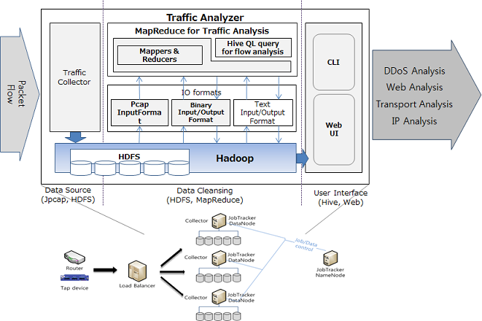
Explored tools:P3(Architecture)

Slide 9
Explored tools:P3
The project is developed by Yeonhee Lee, a former PhD student of Chungnam National University in South Korea
The project is built on Hadoop 1.x
Unfortunately we could not run various JAR files.
We have contacted with author but have not received any feedback from her.

Slide 10
Explored tools: PCAP to Hadoop Sequence
A converter for PCAP file to Hadoop Sequence File Format
Challenge for processing pcap files in Hadoop: Pcap files are not splittable that cannot be used by multiple Hadoop workers at the same time as PCAP file does not have a sync mark.
Hadoop sequence file format is developed for Hadoop and used internally by Hadoop. It consists of key-value pair with sync markers.
http://blog.marouni.fr/jekyll/update/pcap2seq/

Slide 11
Explored tools: PCAP to Hadoop Sequence
Provide compression techniques like GzipCodec or BZip2Codec to use block level compression in sequence file.
We need not to use this as we use a library by RIPE NCC (will discuss later) handle splitting issue.
This library is developed by Abbas Marouni, a software engineer residing in Paris/France.

Slide 12
Explored technique: Processing PCAP files with Apache Spark
PCAP files can be read by 'SparkContext.binaryFiles‘ function. However,
  Read entire binary file as a single record which may degrade performance
We tried to use RDD.pipe function to jpcap to process PCAP file but failed. RDD.pipe method pipes text data into a sub-process and then receives text data back from that process.
That means we need to modify RDD.pipe method to pipe binary data to/from a sub-process.

Slide 13
Explored tools: OpenSOC
Open Source Security – a project dedicated to providing an extensive and scalable advanced security analytics tool.
Initiated by CISCO and tested with Hortonworks
http://opensoc.github.io/

Slide 14
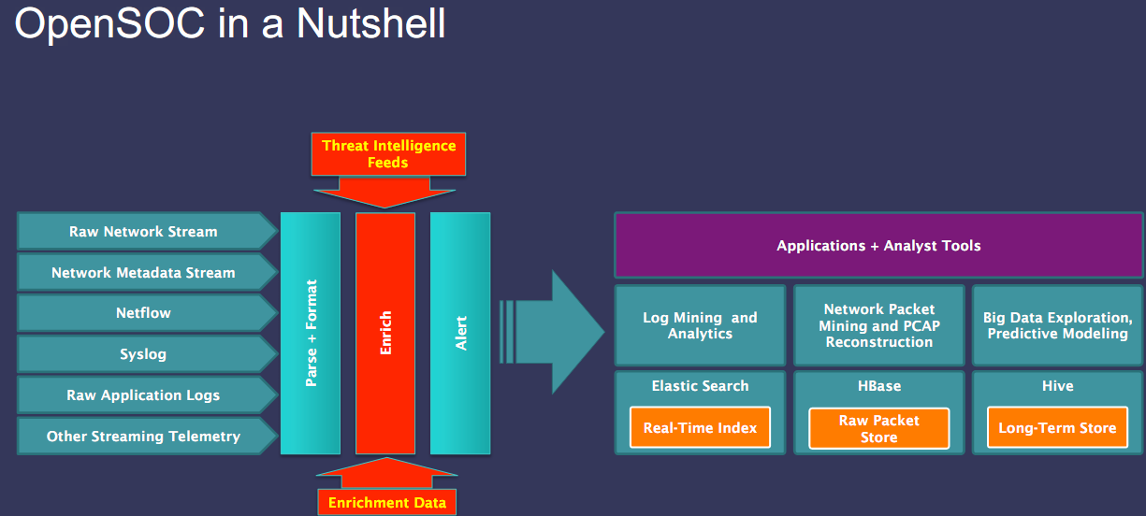
Explored tools: OpenSOC (Architecture)

Slide 15
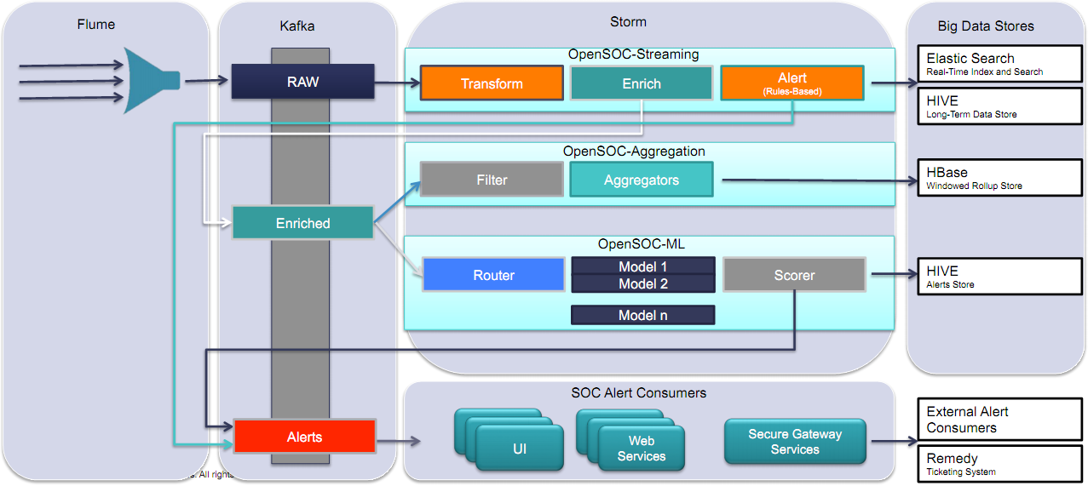
Explored tools: OpenSOC (Architecture)

Slide 16
Explored tools: OpenSOC
Is not easy to install and make ready for working
Does not have a good documentation
For our case, we want to analysis static data
We are working on it.

Slide 17
Explored tools: Hadoop-Pcap
Hadoop-pcap is developed by RIPE-NCC (RIPE Network Coordination Center) lab, in France.
It has two parts
  Library: Bundles of code to read PCAPS and can be used within MapReduce jobs
  SeDe: Implements a Hive Serializer/Deserializer to query PCAPs using SQL like commands.
For this project, we use SeDe which also uses Library internally.
https://github.com/RIPE-NCC/hadoop-pcap

Slide 18
Explored tools: Hadoop-Pcap
Set up for using SeDe in Hive
  ADD JAR hadoop-pcap-serde-0.1-jar-with-dependencies.jar;
  SET hive.input.format=org.apache.hadoop.hive.ql.io.CombineHiveInputFormat;
  SET mapred.max.split.size=104857600;
  SET net.ripe.hadoop.pcap.io.reader.class=net.ripe.hadoop.pcap.PcapReader;

Slide 19
Explored tools: Hadoop-Pcap
CREATE EXTERNAL TABLE pcaps (ts bigint,
protocol string,
src string,
src_port int,
dst string,
dst_port int,
len int,
ttl int)
ROW FORMAT SERDE 'net.ripe.hadoop.pcap.serde.PcapDeserializer'
STORED AS INPUTFORMAT 'net.ripe.hadoop.pcap.io.PcapInputFormat'
OUTPUTFORMAT 'org.apache.hadoop.hive.ql.io.HiveIgnoreKeyTextOutputFormat'
LOCATION 'hdfs://localhost:9000/pcaps/';

Slide 20
Explored tools: Hadoop-Pcap
Sample Hive Query (from terminal)
  hive -e "add jar hadoop-pcap-serde-1.1-SNAPSHOT-jar-with-dependencies.jar; select src,dst,count(*) from pcaps group by src,dst order by src,dst" > /home/mustafa/Spring2015/BigData/Project/Results/withPcapReader/sourcesDestsC.csv
Take more that 2 hours for each query on an average
Can not handle Non-IP addresses

Slide 21
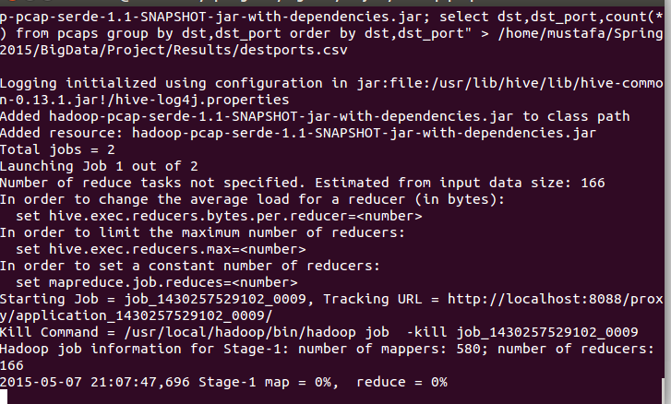
Explored tools: Hadoop-Pcap (Query in single node cluster— getting destination and ports)

Slide 22
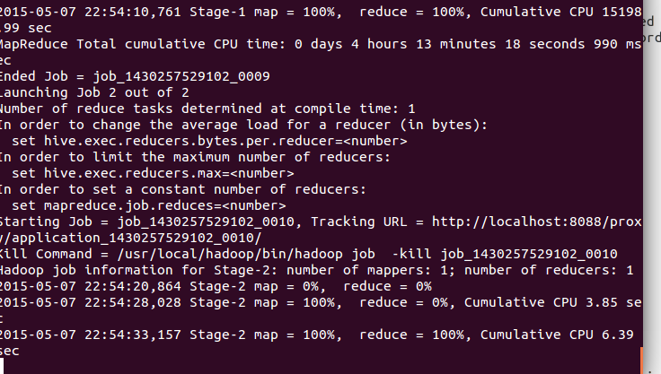
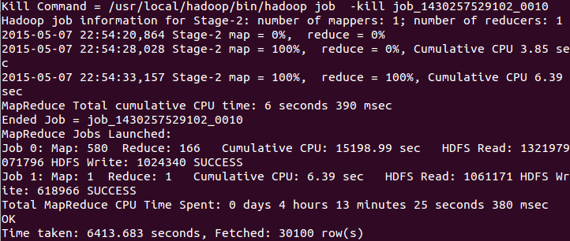
Explored tools: Hadoop-Pcap (Query in single node cluster— getting destination and ports)

Slide 23
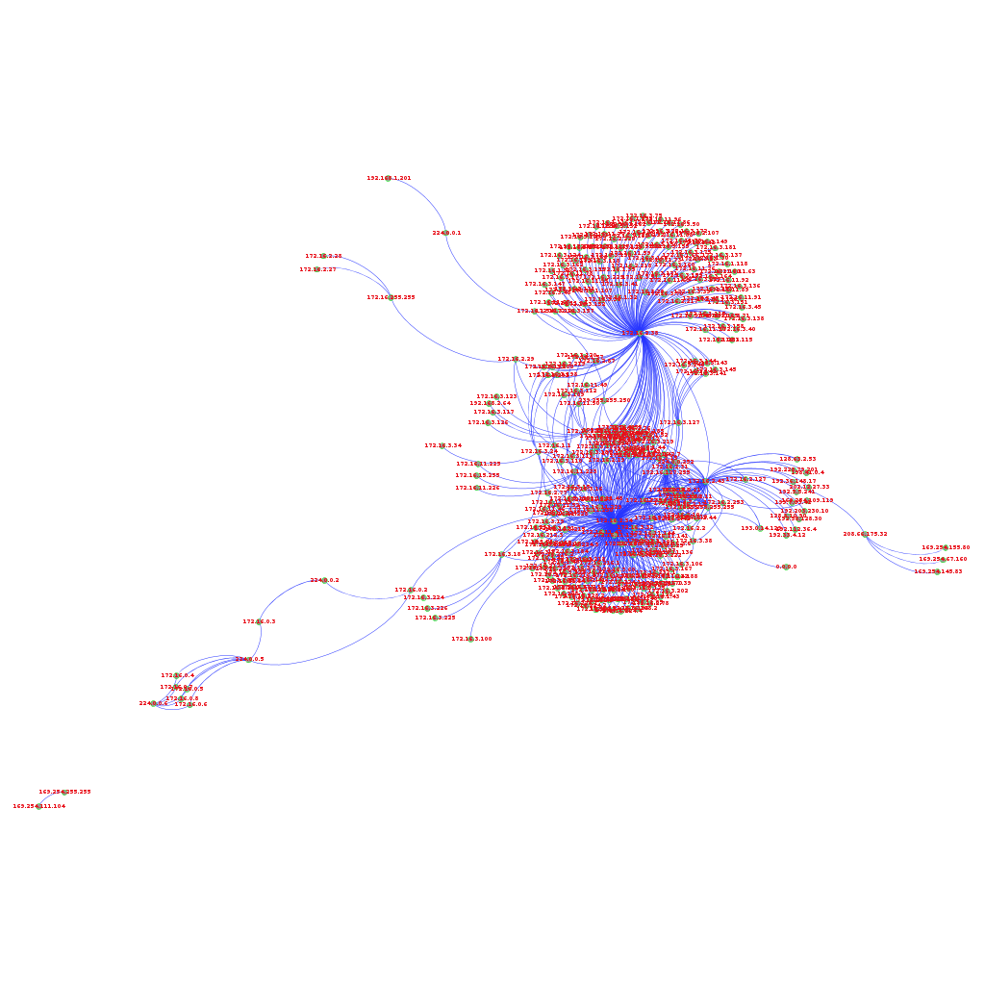
Outcomes (Topology)
Notes:
Drawn by Gephi, an interactive visualization and exploration platform for all kinds of networks and complex systems, dynamic and hierarchical graph.

Slide 24
Outcomes (Topology)
We use Gephi for previous drawing.
There are 342 nodes and 750 edges.

Slide 25

Outcomes (Protocol)
We received a very hand full number of protocols
A significant number of packets are TCP
Hadoop-pcap cannot extract some protocol and
extracted as NULL

Slide 26
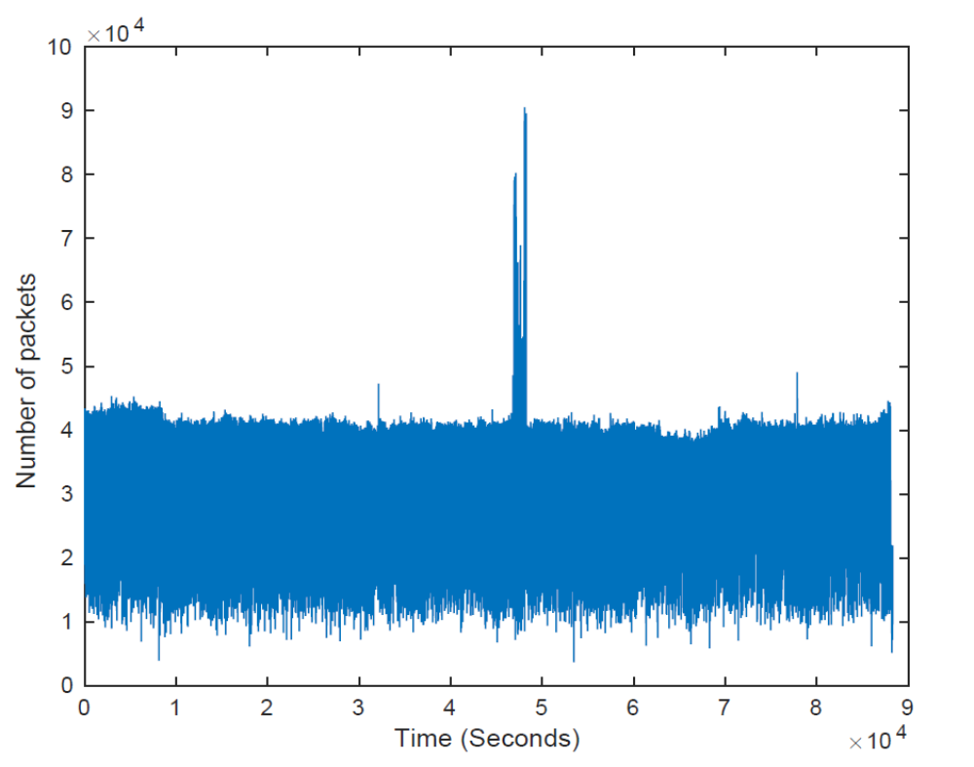
Outcomes (Packet per Second)
Our trace is approximately for one day
Number of packets per second mostly range between about 10,000 to 42,000
There is an apparent spike in the middle of the day.

Slide 27
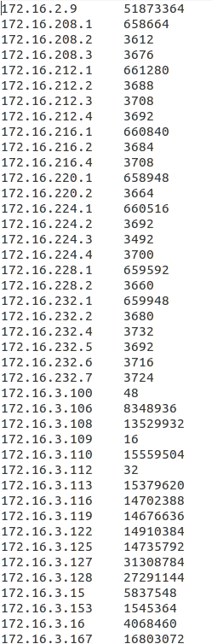
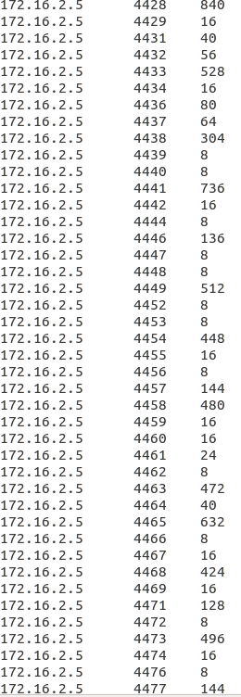
Outcomes (Snap Shot for Source IPs)
Source IP Address Number of Packets
Source IP Address Port Number Number of Packets

Slide 28
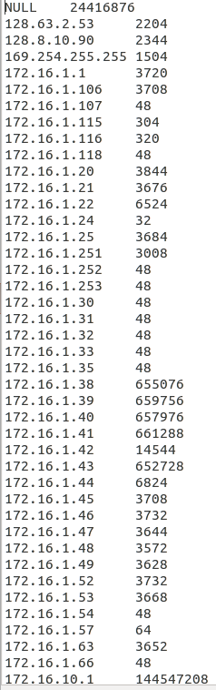
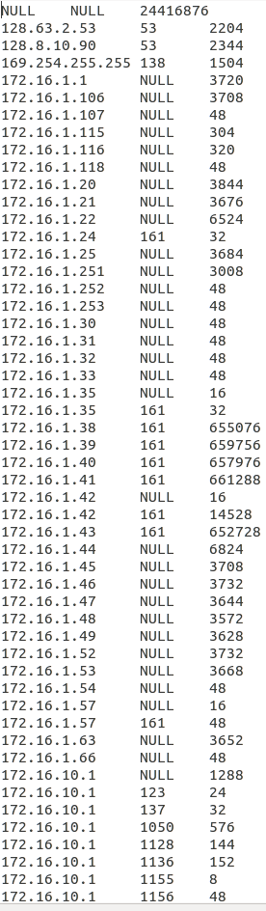
Outcomes (Snap Shot for Destination IPs)
Destination IP Address Number of Packets
Destination IP Address Port Number Number of Packets

Slide 29
Contributions
We make a survey to understand the state-a-art techniques for processing large number of PCAP files in Big data.
Pros and cons of each tools and techniques are extracted.
This will help to develop new tools or improving existing tools for PCAP files processing.
Details analysis with an existing tools (Hadoop Pcap)

Slide 30
On Going and Future Work
We are now working on OpenSOC to make it usable for our purpose.
We will try to improve ‘hadoop-pcap’ by RIPE-NCC to extract information for non-IP packets.
Implementation in Spark is also our target as it will faster than Hive implementation.

Slide 31
Conclusion
Some personal (P3) and industrial (PacketPig) initiatives are done with Hadoop 1.x
However, there is a gap between Hadoop 1 and Hadoop 2 for PCAP file processing.
Hadoop Pcap from RIPE-NCC is still continue their development but it slow and does not support non-IP packets as well as have limited back functionalities.

Slide 32
Conclusion
Apache Spark requires rich API for PCAPs processing
OpenSOC provides a Beta version for PCAPs processing with support
However, it has a great potential for deployment in non-commercial as well as commercial level.
Still PCAPs processing in Big Data area is not mature for large scale deployment.

Slide 33
Thank You

